Slide 1
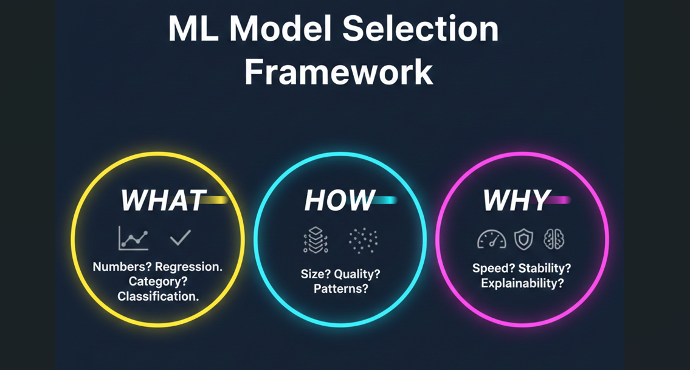
ML Model Selection Framework
Created by Tarun Negi
WHAT am I predicting?
• A number → Regression
• A category /Yes–No → Classification
• Continuous vs Discrete outcome
HOW is my data?
• Small or large dataset?
• Clean or noisy?
• Simple patterns?
• Tabular, text, or image?
WHY this model?
• Better accuracy?
• More stable results?
• Faster to train/use?
• Easier to explain?
↓ Place decision diagram / flowchart here ↓

